Slide 1

BUSINESS ANALYTICS APPLICATIONS
Unit 4

Slide 2
Content
Customer segmentation and profiling using clustering techniques
Market basket analysis and recommendation systems
Time series forecasting and demand prediction
Text analytics and sentiment analysis for customer feedback and social media data

Slide 3
Customer segmentation and profiling
Customer segmentation is a process that divides a broad customer base into smaller, more homogeneous groups or segments.
Clustering techniques are often used to achieve effective segmentation and profiling
to create more targeted marketing strategies
personalize customer experiences
optimize product offerings

Slide 4
Customer segmentation
the goal is to let the numbers and statistics help us be more objective and statistically correct.
The “Business Decision”
The management team of a large shopping mall would like to understand the types of people who are, or could be, visiting their mall.
They have good reasons to believe that there are a few different market segments
services better in order to attract mainly a few profitable market segments, or to differentiate their services (e.g. invitations to events, discounts, etc) across market segments.
The Data
the management team run a market research survey of a few potential customers.
In this case this was a small survey to only a few people, where each person answered six attitudinal questions and a question regarding how often they visit the mall,
all on a scale 1-7, as well as one question regarding their household income:

Slide 5
Table 1: Survey Question Descriptions and Scales
Name | Description | Scale
V1 | Shopping is fun | 1-7
V2 | Shopping is bad for your budget | 1-7
V3 | I combine shopping with eating out | 1-7
V4 | I try to get the best buys while shopping | 1-7
V5 | I don't care about shopping | 1-7
V6 | You can save a lot of money by comparing prices | 1-7
Income | The household income of the respondent | Dollars
Mall.Visits | How often they visit the mall | 1-7

Slide 6
Table 2: Responses of the First 10 People
ID | V1 | V2 | V3 | V4 | V5 | V6 | Income | Mall.Visits
1 | 6 | 4 | 7 | 3 | 2 | 3 | 60000 | 3
2 | 2 | 3 | 1 | 4 | 5 | 4 | 30000 | 1
3 | 7 | 2 | 6 | 4 | 1 | 3 | 70000 | 3
4 | 4 | 6 | 4 | 5 | 3 | 6 | 30000 | 7
5 | 1 | 3 | 2 | 2 | 6 | 4 | 60000 | 1
6 | 6 | 4 | 6 | 3 | 3 | 4 | 50000 | 2
7 | 5 | 3 | 6 | 3 | 3 | 4 | 65000 | 3
8 | 7 | 3 | 7 | 4 | 1 | 4 | 55000 | 4
9 | 2 | 4 | 3 | 3 | 6 | 3 | 70000 | 0
10 | 3 | 5 | 3 | 6 | 4 | 6 | 25000 | 6

Slide 7
How to Conduct Customer Segmentation and Profiling:
Data Collection:
Gather comprehensive data on your customers, including demographics, purchase history, online behavior, and preferences.
Data Analysis:
Use statistical analysis to categorize customers into segments based on shared characteristics. Common segmentation includes demographic, psychographic, behavioral, and geographical segmentation.
Profile Development:
Develop profiles for each segment, which includes common needs, preferred communication channels, and potential barriers to purchase.
Tailored Strategies:
Create targeted marketing campaigns and product development strategies for each segment to address their specific needs and preferences.
Monitoring and Adapting:
Continuously monitor the performance of each segment and adapt your strategies as customer behaviors and market conditions change.

Slide 8
Examples of Customer Segmentation and Profiling:
Demographic Segmentation:
Dividing the market into groups based on variables such as age, gender, income, occupation, and family status.
Behavioural Segmentation:
Grouping by purchase history, loyalty to the brand, user status, or usage rate.
Psychographic Segmentation:
Segmenting according to lifestyle, personality traits, values, opinions, and interests of consumers.
Geographical Segmentation:
Categorizing customers by geographic boundaries such as nations, states, regions, cities, or neighbourhoods.

Slide 9
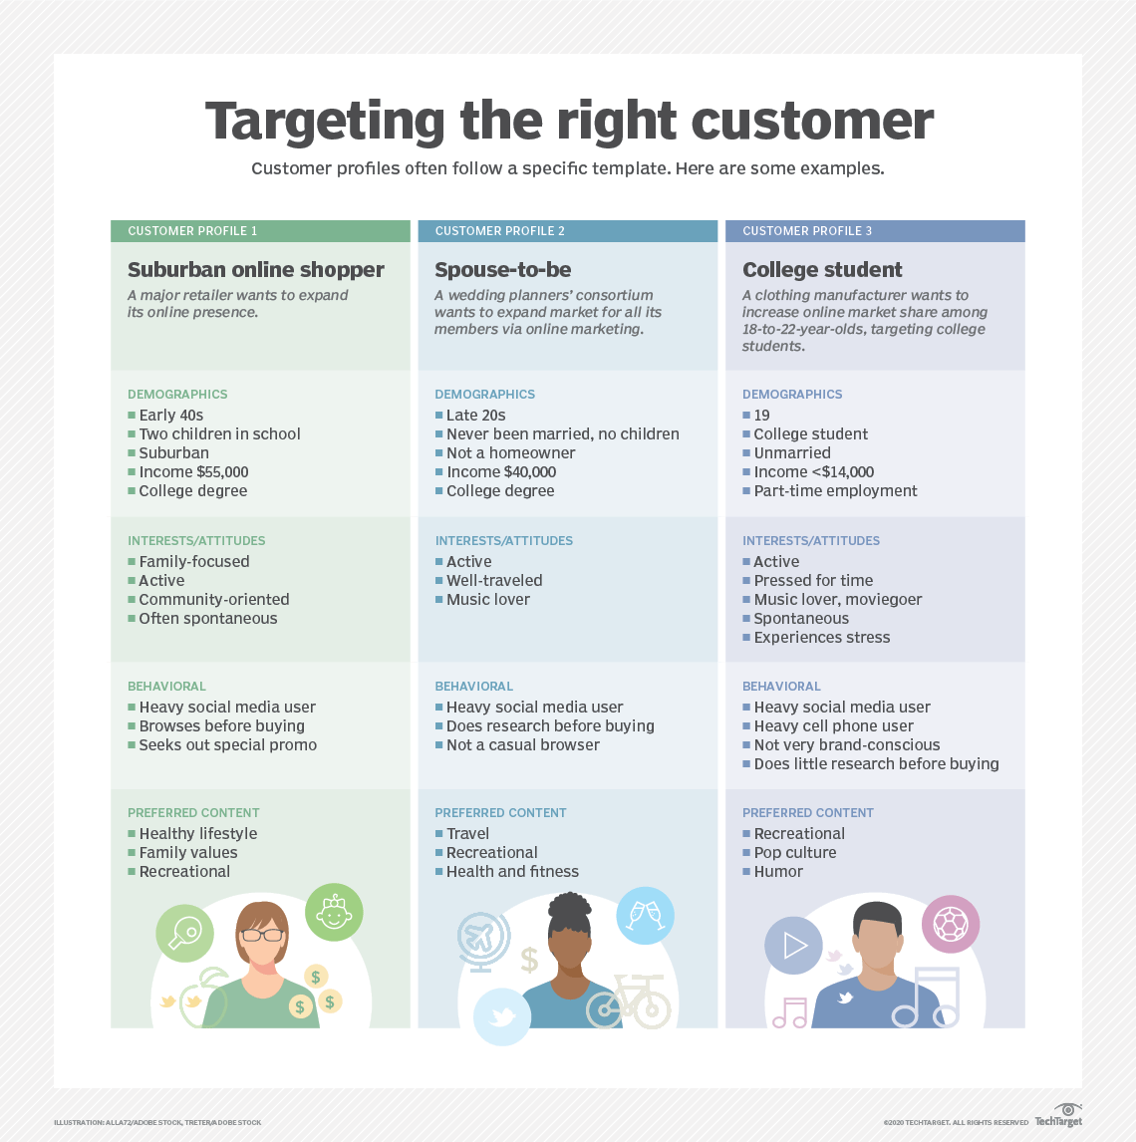

Slide 10
Time Series Analysis and Forecasting

Slide 11
Introduction to Time Series Analysis
A time-series is a set of observations on a quantitative variable collected over time.
Examples
Dow Jones Industrial Averages
Historical data on sales, inventory, customer counts, interest rates, costs, etc
Businesses are often very interested in forecasting time series variables.
Often, independent variables are not available to build a regression model of a time series variable.
In time series analysis, we analyze the past behavior of a variable in order to predict its future behavior.

Slide 12
Methods used in Forecasting
Regression Analysis
Time Series Analysis (TSA)
A statistical technique that uses time-series data for explaining the past or forecasting future events.
The prediction is a function of time (days, months, years, etc.)
No causal variable; examine past behavior of a variable and and attempt to predict future behavior

Slide 13
Components of TSA
Time Frame (How far can we predict?)
short-term (1 - 2 periods)
medium-term (5 - 10 periods)
long-term (12+ periods)
No line of demarcation
Trend
Gradual, long-term movement (up or down) of demand.
Easiest to detect

Slide 14
Components of TSA (Cont.)
Cycle
An up-and-down repetitive movement in demand.
repeats itself over a long period of time
Seasonal Variation
An up-and-down repetitive movement within a trend occurring periodically.
Often weather related but could be daily or weekly occurrence
Random Variations
Erratic movements that are not predictable because they do not follow a pattern

Slide 15
Time Series Plot

Slide 16
Components of TSA (Cont.)
Difficult to forecast demand because...
There are no causal variables
The components (trend, seasonality, cycles, and random variation) cannot always be easily or accurately identified

Slide 17
Some Time Series Terms
Stationary Data - a time series variable exhibiting no significant upward or downward trend over time.
Nonstationary Data - a time series variable exhibiting a significant upward or downward trend over time.
Seasonal Data - a time series variable exhibiting a repeating patterns at regular intervals over time.

Slide 18
Approaching Time Series Analysis
There are many, many different time series techniques.
It is usually impossible to know which technique will be best for a particular data set.
It is customary to try out several different techniques and select the one that seems to work best.
To be an effective time series modeler, you need to keep several time series techniques in your “tool box.”

Slide 19
Moving Averages
No general method exists for determining k.
We must try out several k values to see what works best.

Slide 20
Weighted Moving Average
The moving average technique assigns equal weight to all previous observations
The weighted moving average technique allows for different weights to be assigned to previous observations.
We must determine values for k and the w_{i}

Slide 21
Trend Models
Trend is the long-term sweep or general direction of movement in a time series.
We’ll now consider some nonstationary time series techniques that are appropriate for data exhibiting upward or downward trends.

Slide 22
The Linear Trend Model
For example:

Slide 23
The TREND() Function
TREND(Y-range, X-range, X-value for prediction)
where:
Y-range is the spreadsheet range containing the dependent Y variable,
X-range is the spreadsheet range containing the independent X variable(s),
X-value for prediction is a cell (or cells) containing the values for the independent X variable(s) for which we want an estimated value of Y.
Note: The TREND( ) function is dynamically updated whenever any inputs to the function change. However, it does not provide the statistical information provided by the regression tool. It is best two use these two different approaches to doing regression in conjunction with one another.

Slide 24
Combining Forecasts
It is also possible to combine forecasts to create a composite forecast.
Suppose we used three different forecasting methods on a given data set.
Denote the predicted value of time period t using each method as follows:
We could create a composite forecast as follows:

